Slide 1
Server Side Caching
Strategy
A Quick Overview of
Sumonta Saha Mridul
Trainee Software Engineer
Cefalo Bangladesh LTD.

Slide 2


Slide 3
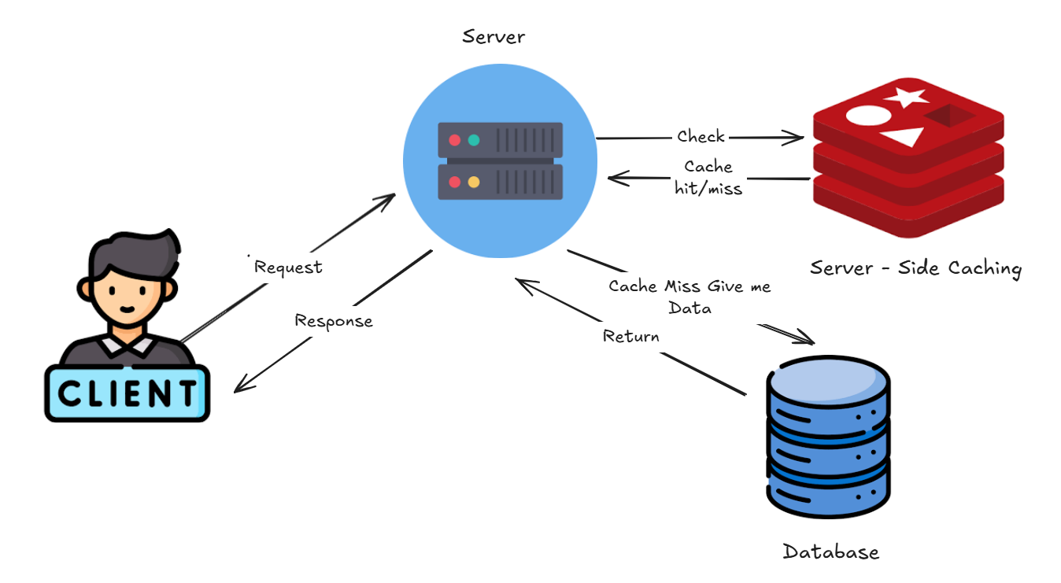
What is Server Side Caching?
Server-side caching generally refers to the cache layer positioned between the server's application logic and the database.

Slide 4
What is Cache Hit & Cache Miss?

Slide 5
What is Cache Hit?
Requested data is already stored in the cache
The cache quickly returns the data without needing to fetch it from the original source, saving time and resources.

Slide 6
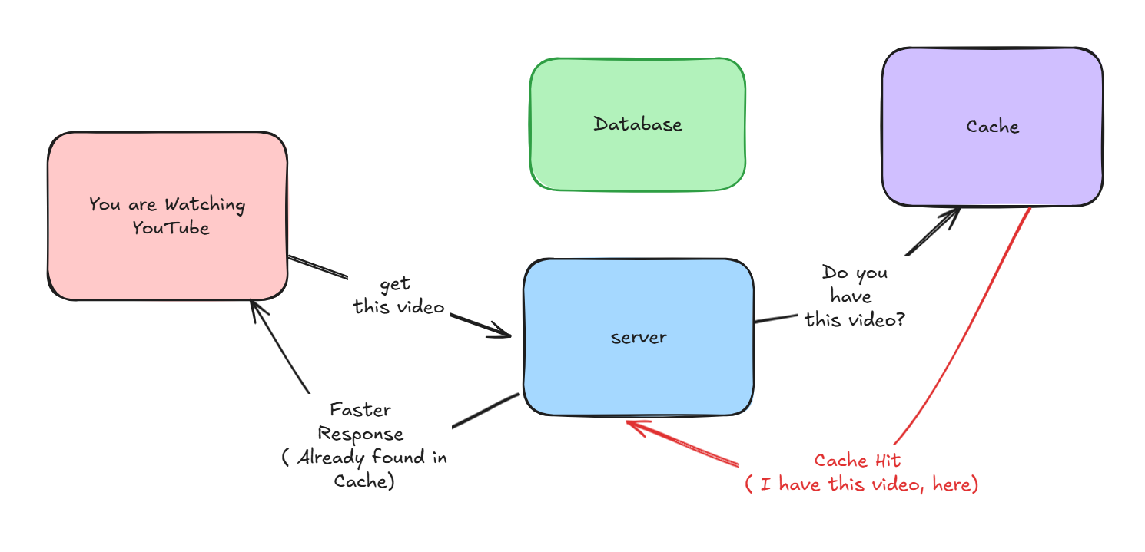
What is Cache Hit?

Slide 7
What is Cache Miss?
Requested data is not stored in the cache
The system fetches the data from the original source (like a database or server), which takes more time.

Slide 8
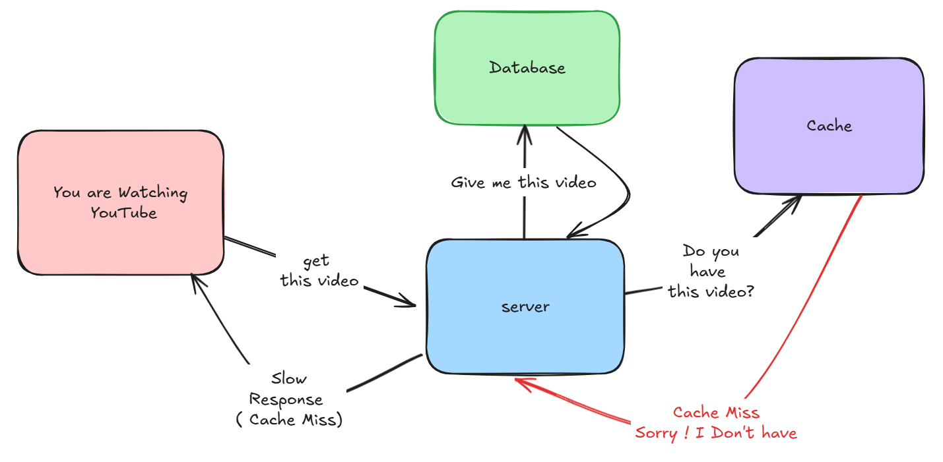
What is Cache Miss?

Slide 9
Cache Aside
Caching Strategy

Slide 10
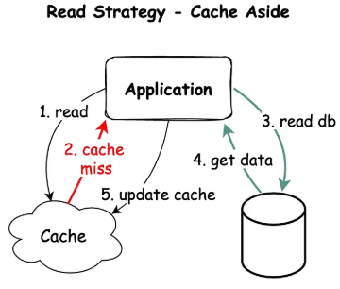
Cache Aside Strategy
First check cache for data
Cache Hit ! Return data to Client
Cache Miss !
Server Fetch data from DB
Store data in Cache
Return data to client

Slide 11
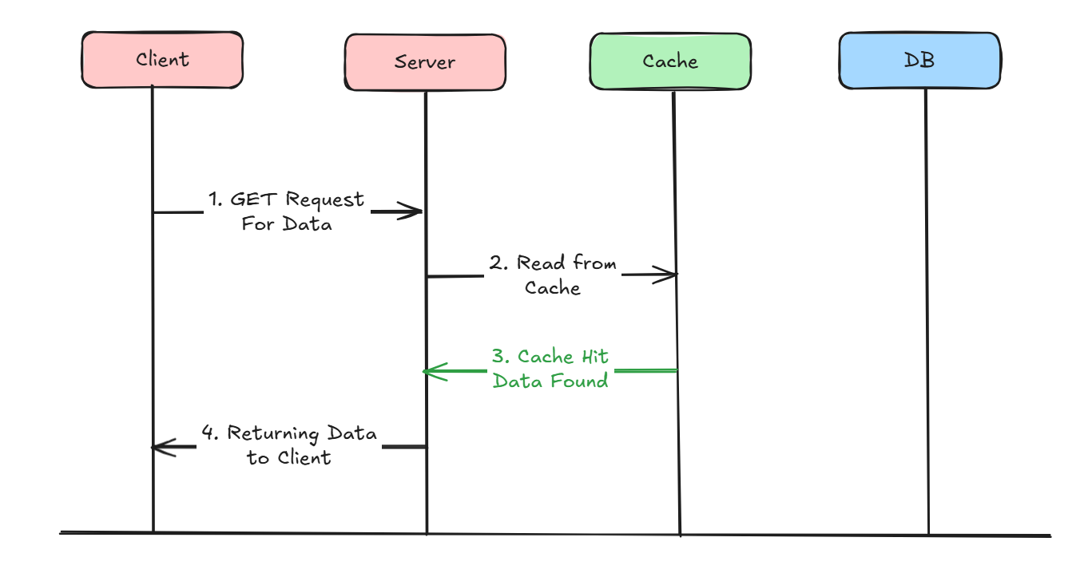
What happens in Cache Hit?

Slide 12
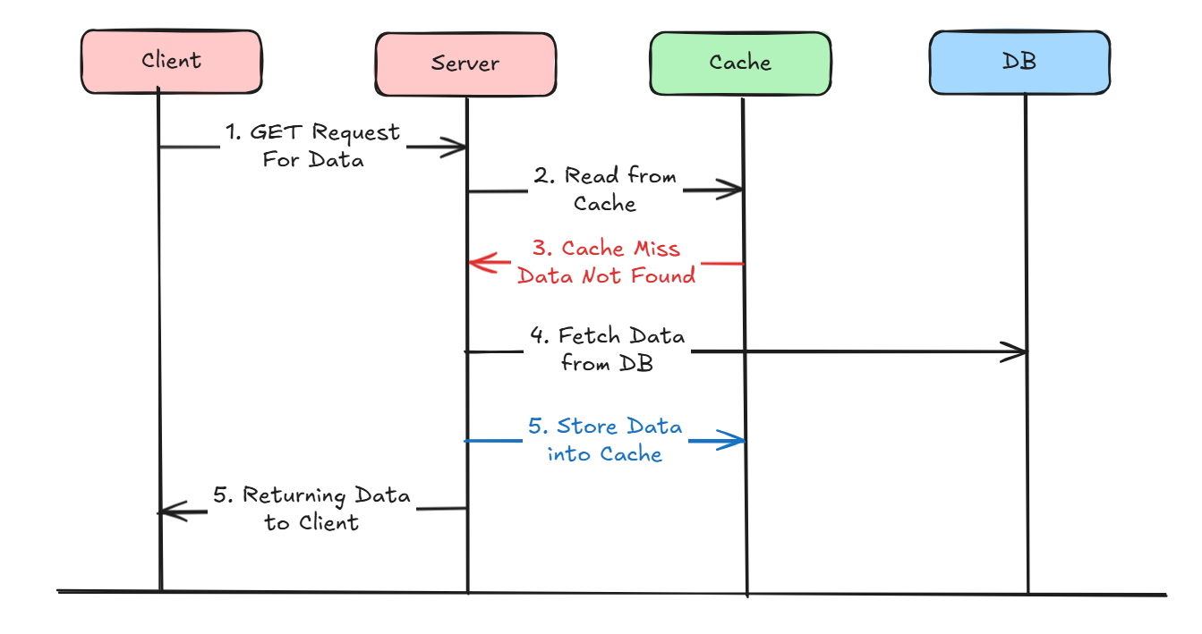
What happens in Cache Miss?

Slide 13
Cache Aside : Advantages
Good Approach for Heavy Read applications
Even Cache is down, request will not fail, It will directly fetch from data.
Cache document data structure can be different that data present in DB

Slide 14
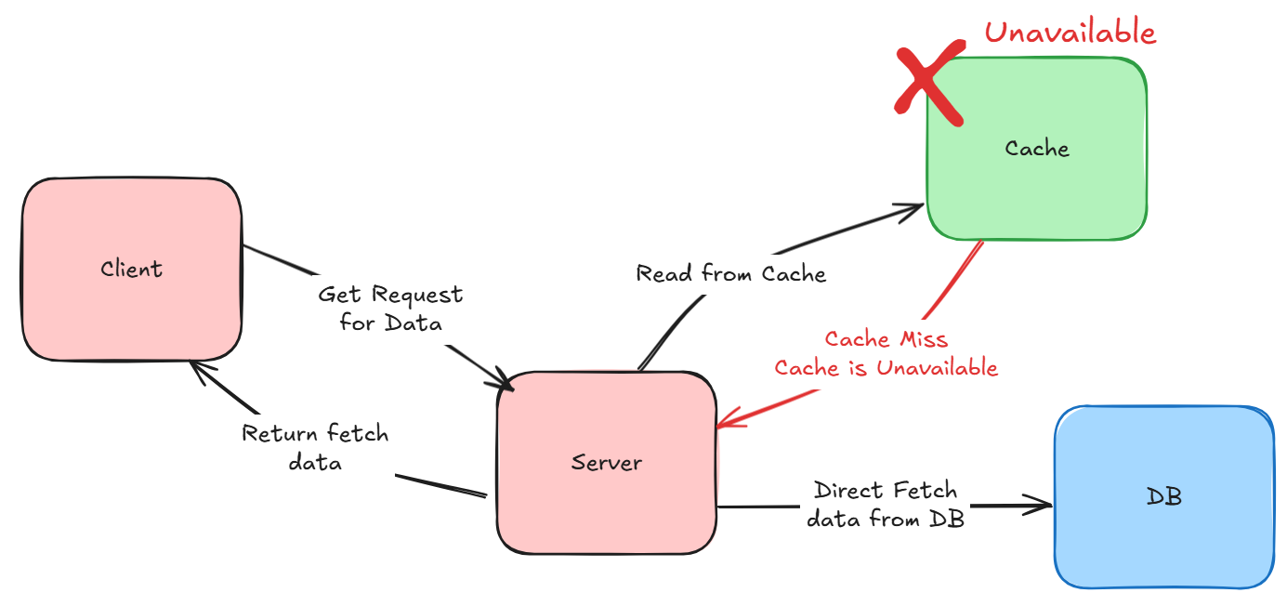
Even Cache is down, request will not fail, It will directly fetch from data.

Slide 15
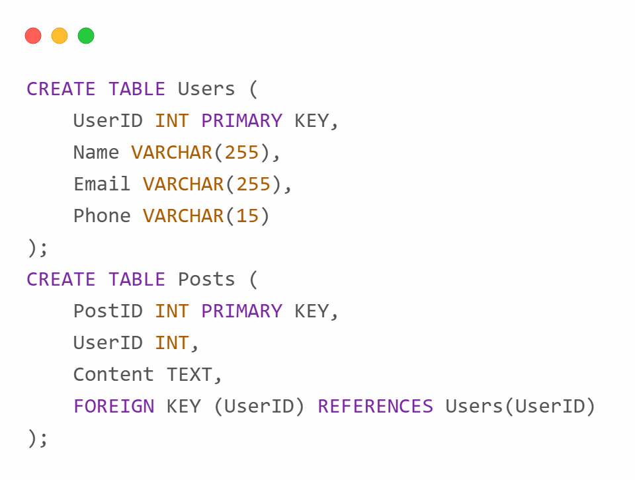
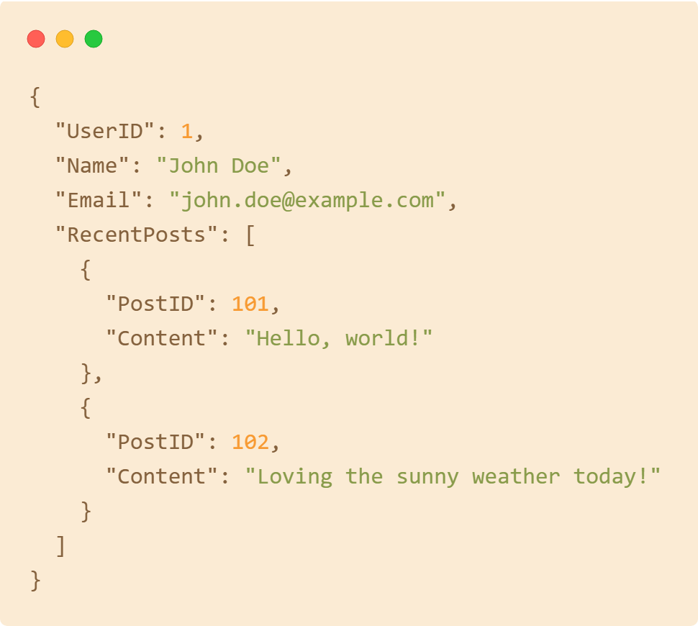
Cache document data structure can be different that data present in DB
Database (Structured for Storage)
Cache (Optimized for Access)

Slide 16
Example Use Case:
A user visits John Doe's profile.
The app first checks the cache (user:1).
If found, it returns the cached profile data immediately.
If not in the cache:
The app queries the database, aggregates the data (joins Users and Posts tables), and stores it in the cache for future requests.

Slide 17
Cache Aside : Cons
Write Only Method will always directly write to DB
For new data read, there will always be Cache - Miss first.
If appropriate caching is not used during write operation, there is a chance of inconsistency between Cache and DB

Slide 18
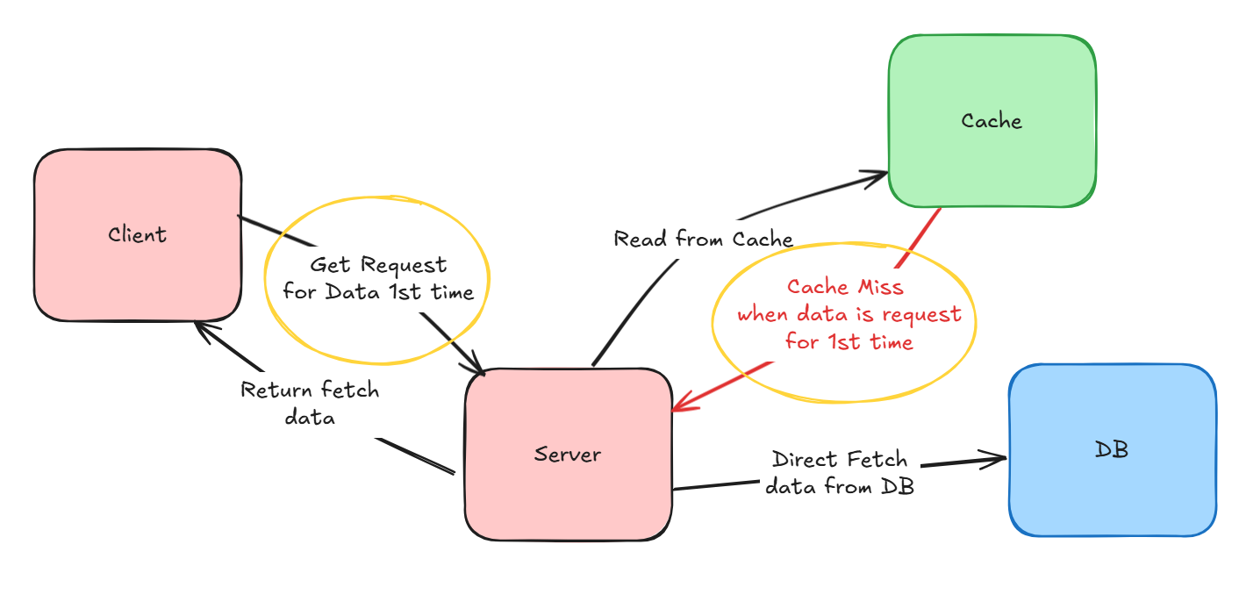
For new data read, there will always be Cache - Miss first.

Slide 19
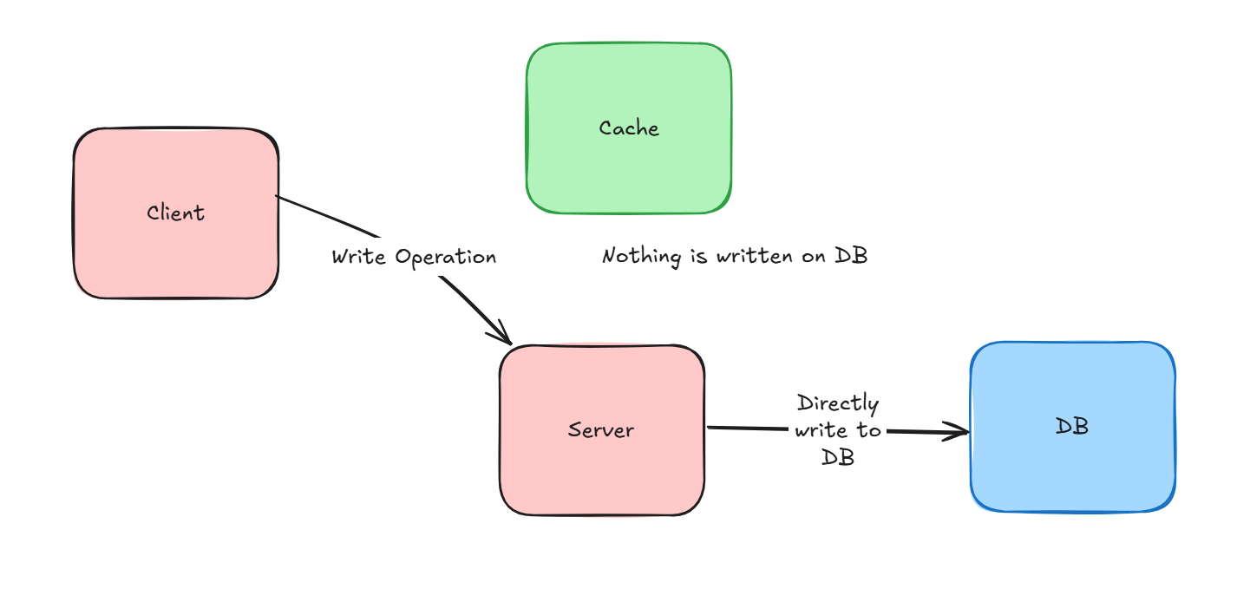
Write Only Method will always directly write to DB

Slide 20
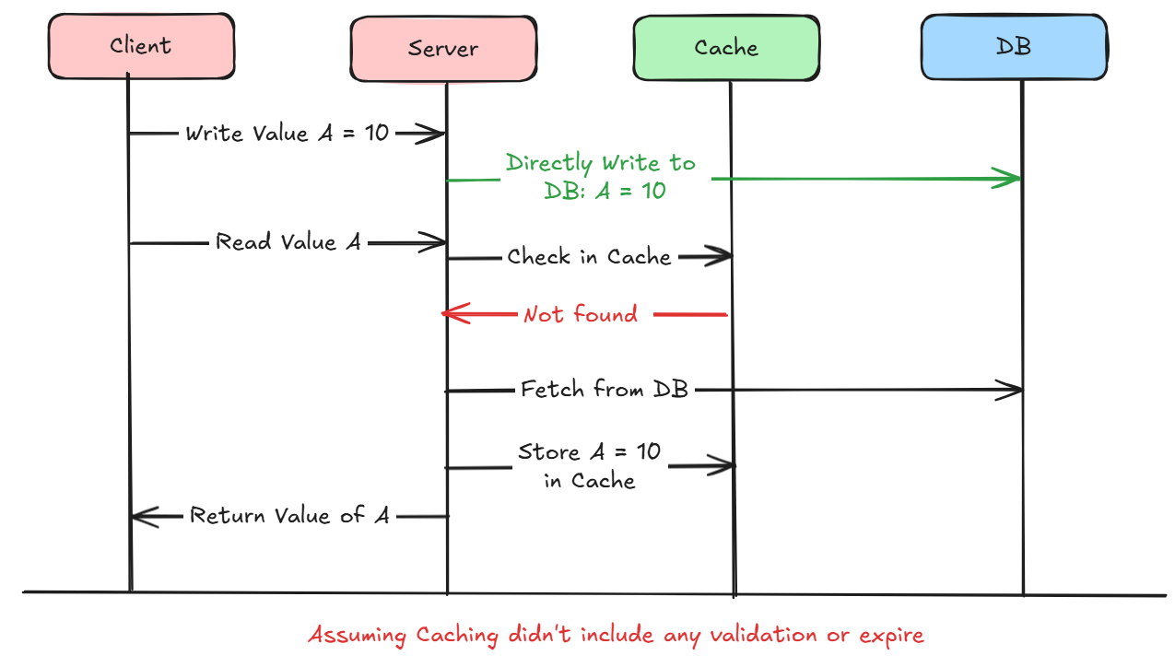
If appropriate caching is not used during write operation, there is a chance of inconsistency between Cache and DB

Slide 21
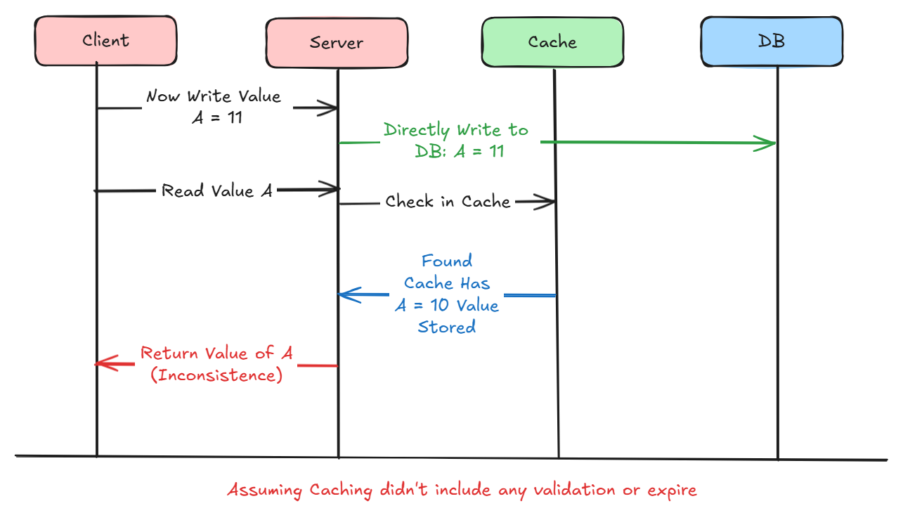
If appropriate caching is not used during write operation, there is a chance of inconsistency between Cache and DB

Slide 22
Read Through
Caching Strategy

Slide 23
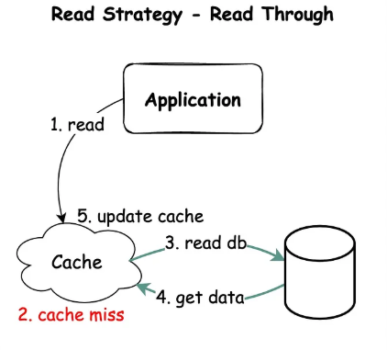
Read Through Strategy
First check cache for data
Cache Hit ! Return data to Client
Cache Miss !
Fetch data from DB
Store data in Cache
Return data to server

Slide 24
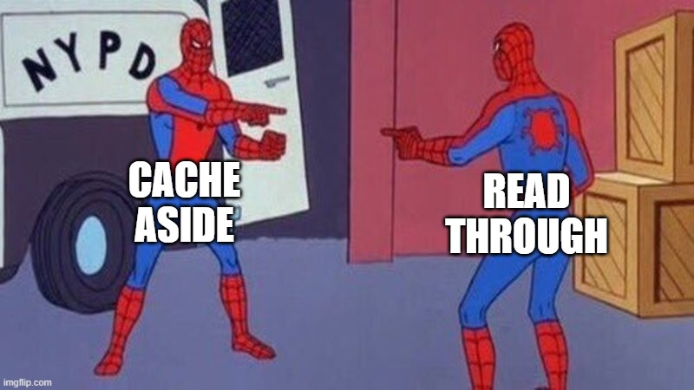
What’s the difference then?

Slide 25
What’s the difference then?
If cache miss, application or server takes the responsibility
Fetch data from DB
Store data in Cache
Return it to Client
( Server has to do all of this task)
If cache miss, cache library takes the responsibility
Fetch data from DB
Store data in Cache
Return it to server
( Server has no tasks to do here)
Cache Aside
Read Through

Slide 26

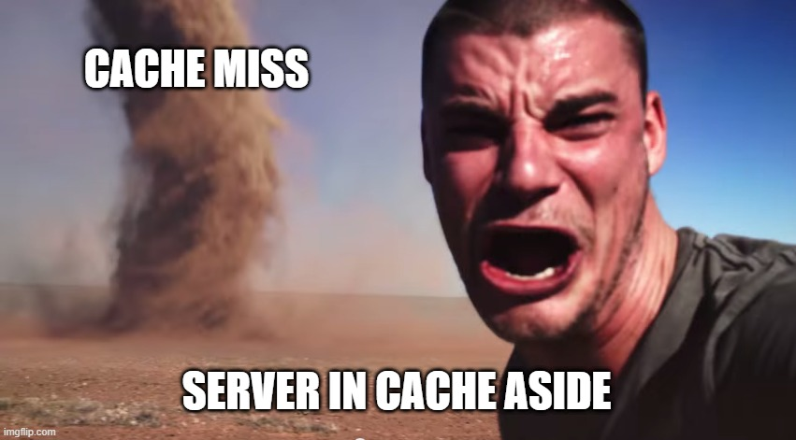
Notes:
Cache hit or Miss, Server no need to deal with it cause everything will be handled by Cache Library
If Cache Miss, now server has to do so many things fetching data and storing it in cache

Slide 27
What happens in Cache Hit? (Same)

Slide 28
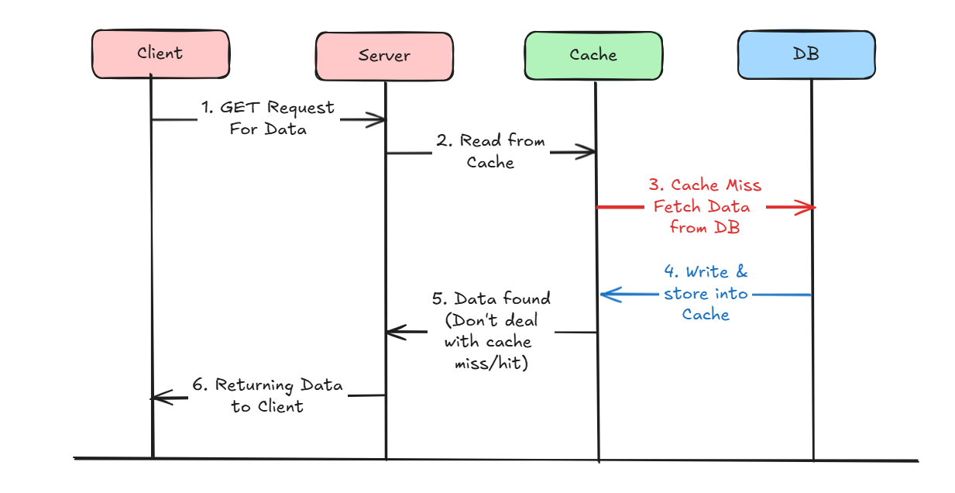
What happens in Cache Miss?

Slide 29
Read Through : Advantages
Good Approach for Heavy Read applications
Server don’t need to worry about whether it is a cache hit or miss
Offloads the responsibility from the application, resulting in simpler application code.

Slide 30
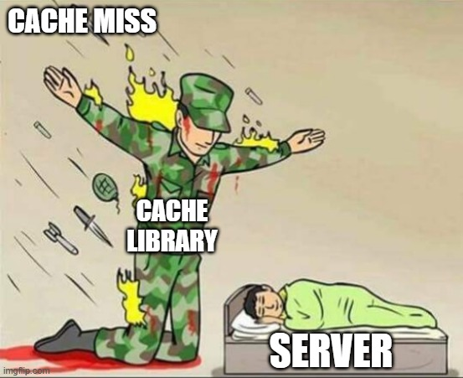
Server don’t need to worry about whether it is a cache hit or miss

Slide 31
Read Through : Cons
Write Only Method will always directly write to DB
For new data read, there will always be Cache - Miss first.
If appropriate caching is not used during write operation, there is a chance of inconsistency between Cache and DB

Slide 32
Read Through : Cons
Cache document data structure can not be different that data present in DB
If Cache goes down, request will fail, since the application interacts only with the cache.

Slide 33
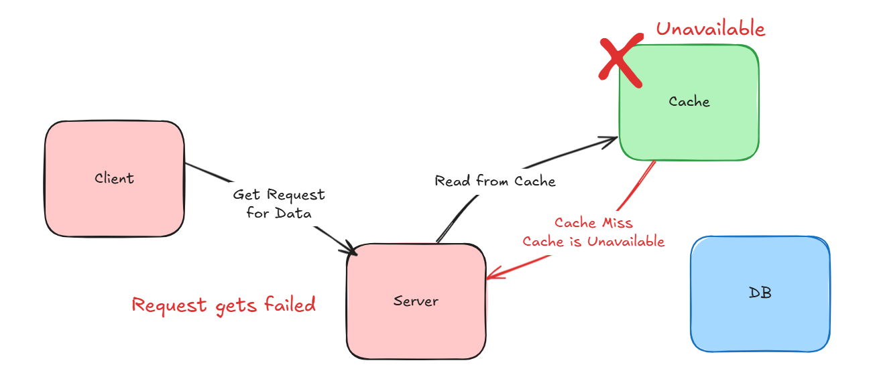
If Cache goes down, request will fail, since the application interacts only with the cache.

Slide 34

Cache document data structure can not be different that data present in DB
Database (Structured for Storage)
Cache (Optimized for Access)

Slide 35
Write Around
Caching Strategy

Slide 36
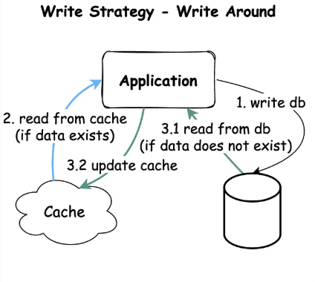
Write Around Strategy
Directly writes data into the database
For Read : Choose between
Cache Aside
Read Through

Slide 37
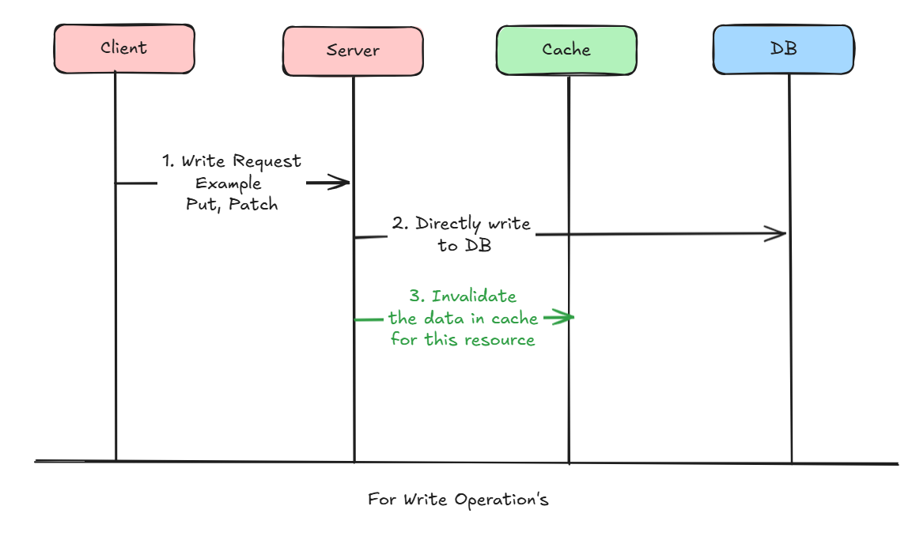
How write operation works?

Slide 38
What to do when read operations?
Have to choose a strategy between Cache Aside & Read Through

Slide 39
Combination of
Read : Cache Aside
Write : Write Around

Slide 40
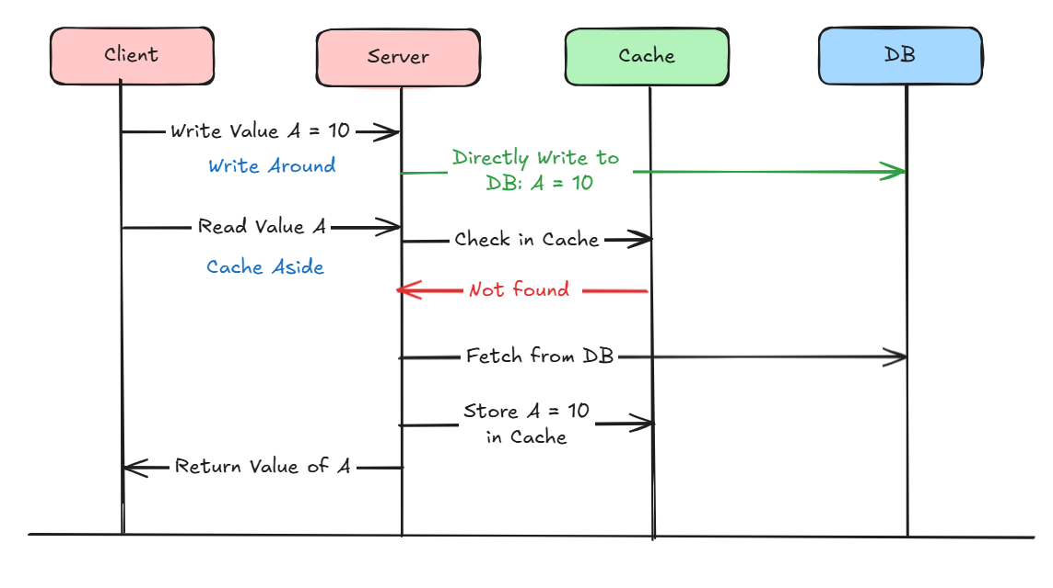
Combination of Cache Aside & Write Around Strategy

Slide 41
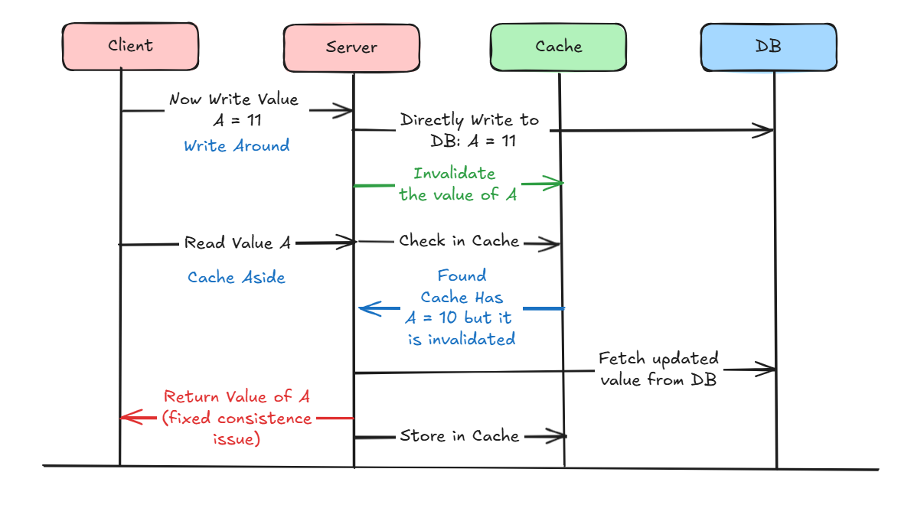
Combination of Cache Aside & Write Around Strategy

Slide 42
Write Around : Advantages
Good Approach for Heavy Read applications
Resolves the inconsistency problem between Cache and DB

Slide 43
Write Around : Cons
For new data read, there will always be Cache - Miss first.
If DB is down, request for write operation will fail

Slide 44
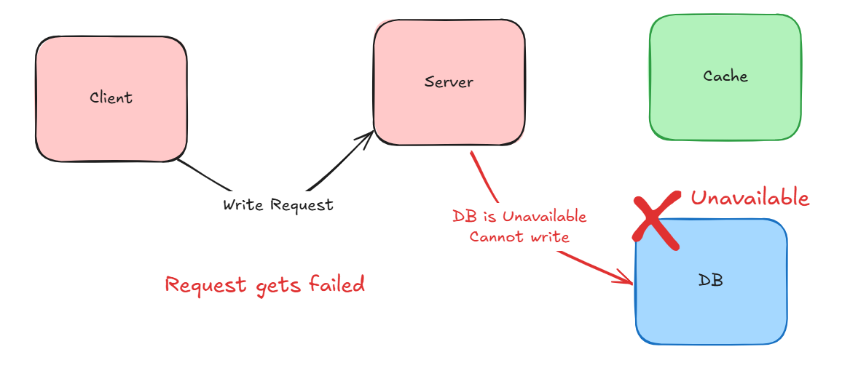
If DB is down, request for write operation will fail

Slide 45
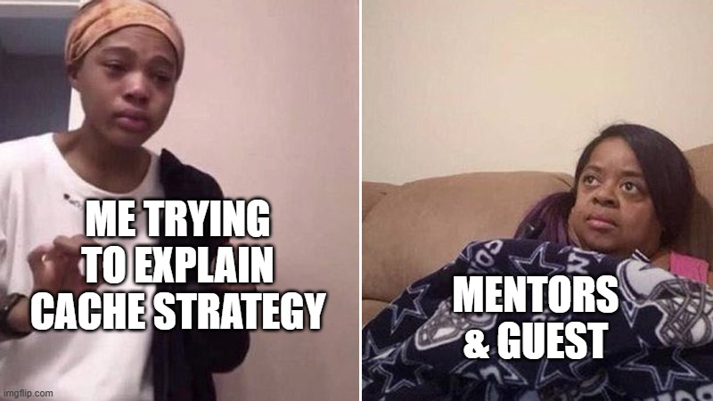

Slide 46
Write Through
Caching Strategy

Slide 47
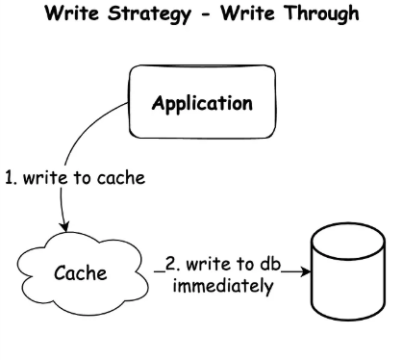
Write Through Strategy
First writes data into the cache
Then in synchronous write data into the DB
For Read : Choose between
Cache Aside
Read Through

Slide 48
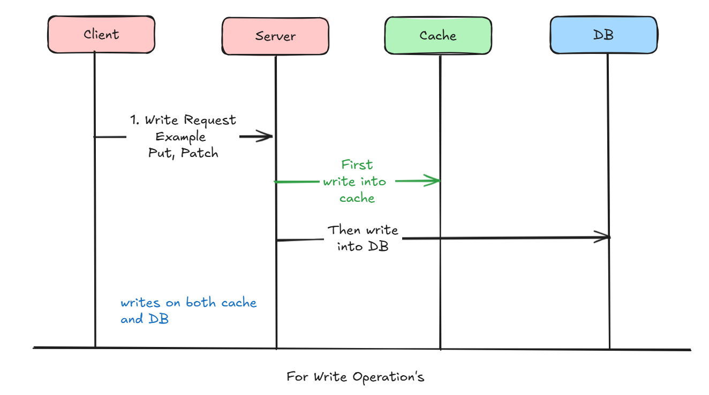
How write operation works?

Slide 49
What to do when read operations?
Have to choose a strategy between Cache Aside & Read Through

Slide 50
Write Through : Advantages
Resolves the inconsistency problem between Cache and DB
Increase Cache Hit chances : Even if for new data read there is a chance of cache hit

Slide 51
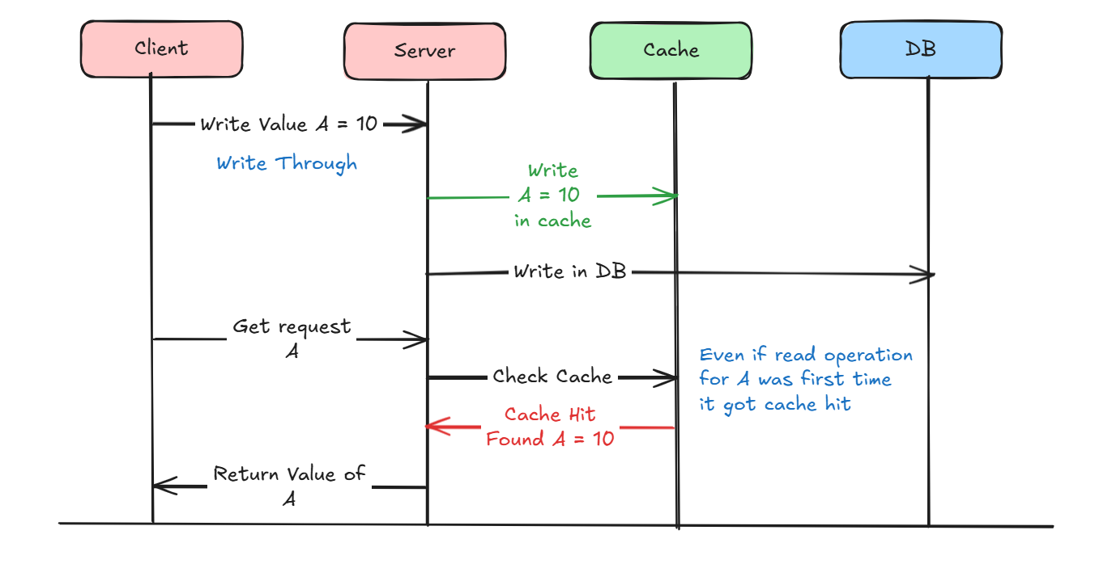
Increase Cache Hit chances : Even if for new data read there is a chance of cache hit

Slide 52
Write Through : Cons
If any of DB or Cache is Unavailable, request will fail.
2 phase commit, need to be applied to maintain transaction property

Slide 53
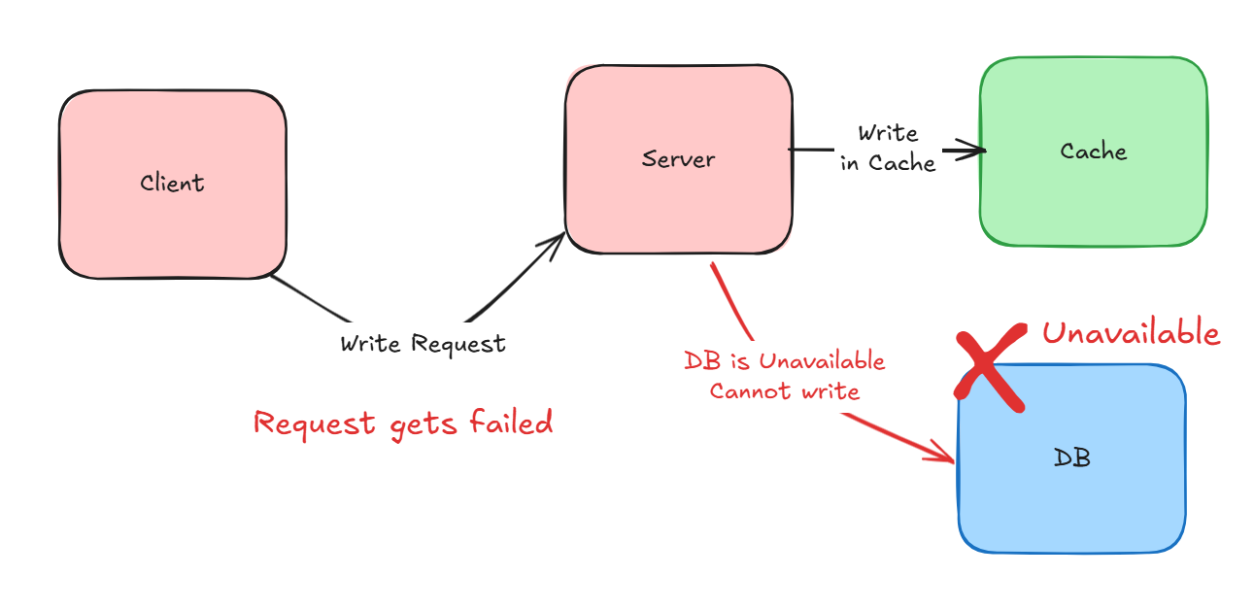
If DB is down, request for write operation will fail
Even if cache is available

Slide 54
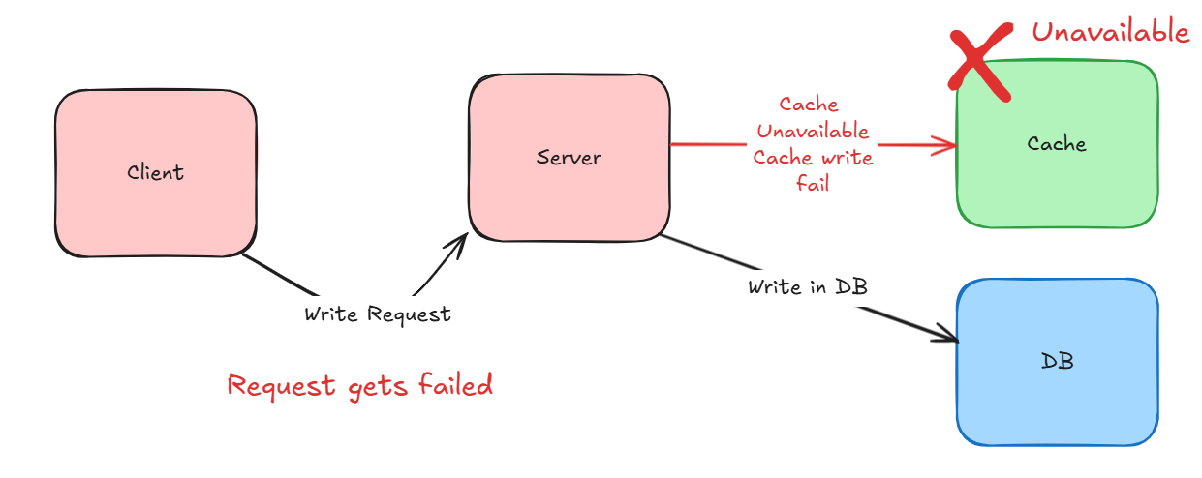
If Cache is down, request for write operation will fail Even if DB is available

Slide 55
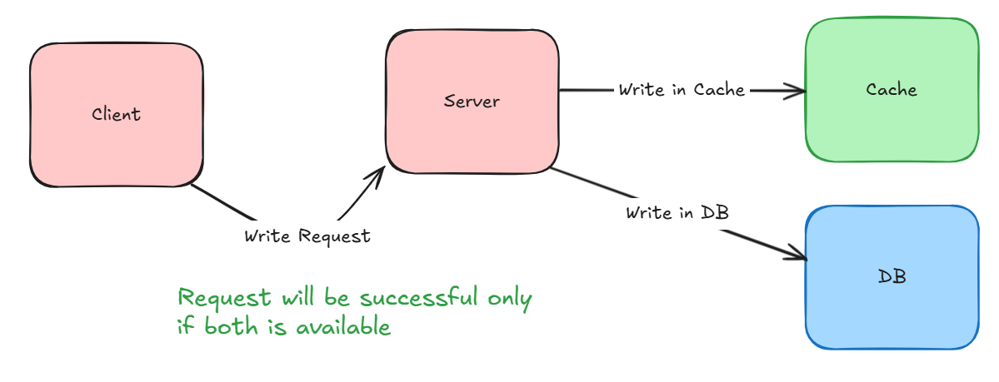
Both Cache and DB must be available for successful operation

Slide 56
Write in Cache | Write in DB | Action Output
Successful | Failed (Unavailable) | Roll back write in cache
Failed (Unavailable) | Successful | Roll back write in DB
Successful | Successful | Okay !
2 phase commit, need to be applied to maintain transaction property

Slide 57
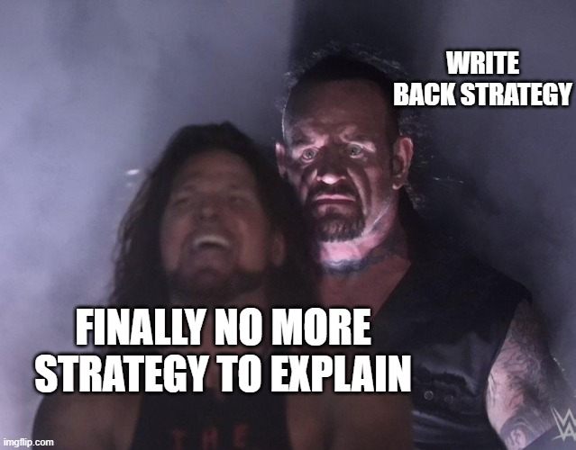

Slide 58
Write Back
Caching Strategy

Slide 59
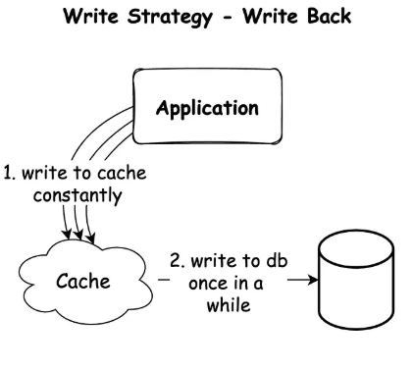
Write Back Strategy
First writes data into the cache
Then in asynchronous write data into the DB
For Read : Choose between
Cache Aside
Read Through

Slide 60
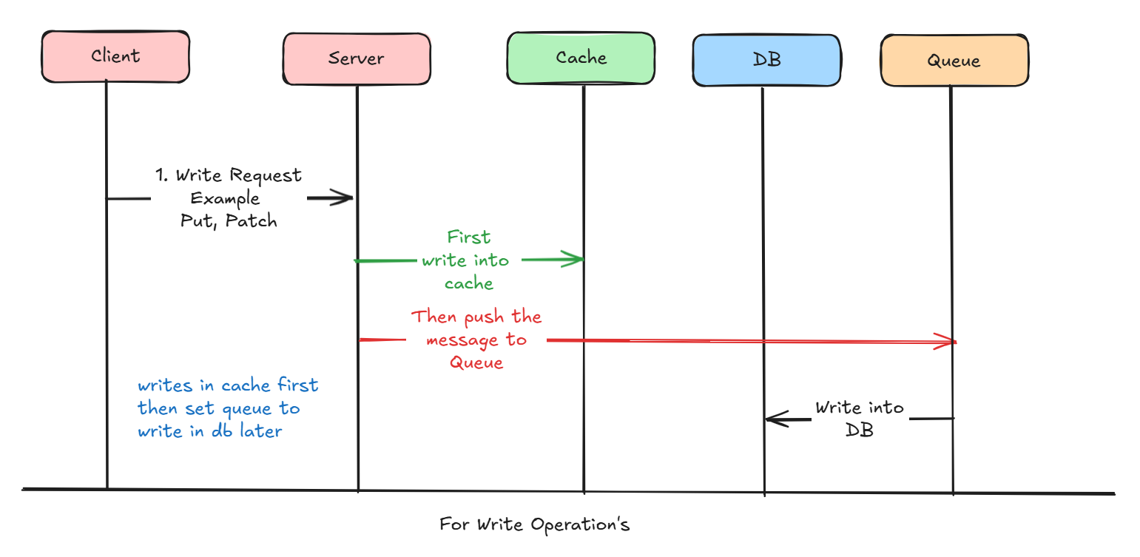
How write operation works?

Slide 61
What to do when read operations?
Have to choose a strategy between Cache Aside & Read Through

Slide 62
Write Back : Advantages
Resolves the inconsistency problem between Cache and DB
Increase Cache Hit chances : Even if for new data read there is a chance of cache hit

Slide 63
Write Back : Advantages
Good for Write Heavy Applications
Improves the write operation latency as writing into DB happens asynchronously
Even if DB Fails, Write Operation will still works

Slide 64
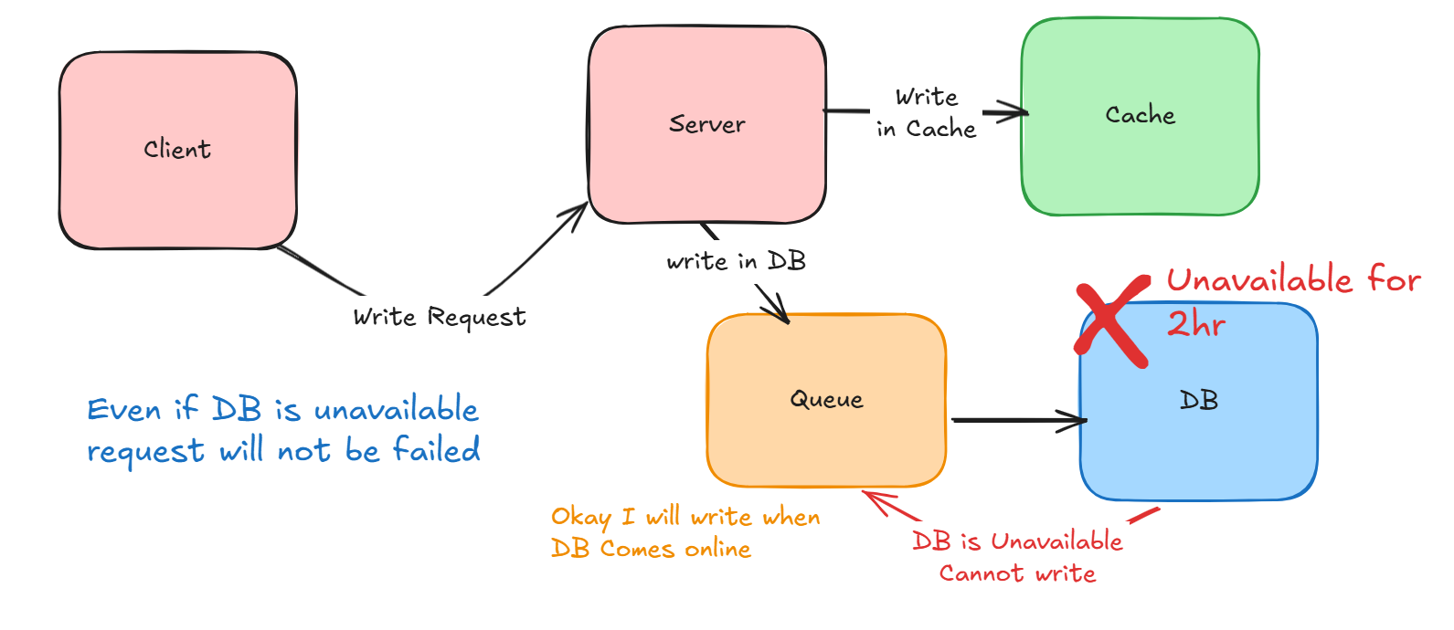
Even if DB Fails, Write Operation will still works

Slide 65
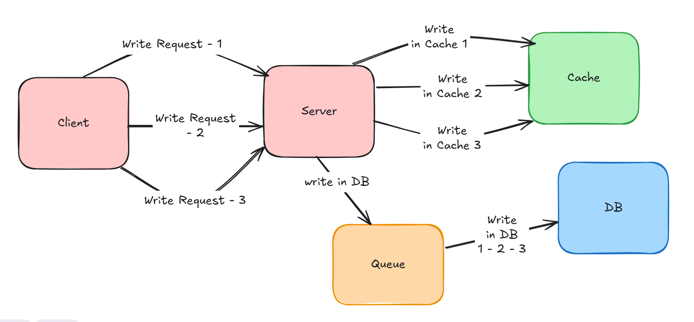
Improves the write operation latency as writing into DB happens asynchronously

Slide 66
Write Back : Cons
Chance of issues when data is removed from cache and DB write still not happen yet
Write-back caching improves performance but risks data loss, complexity, and consistency issues

Slide 67
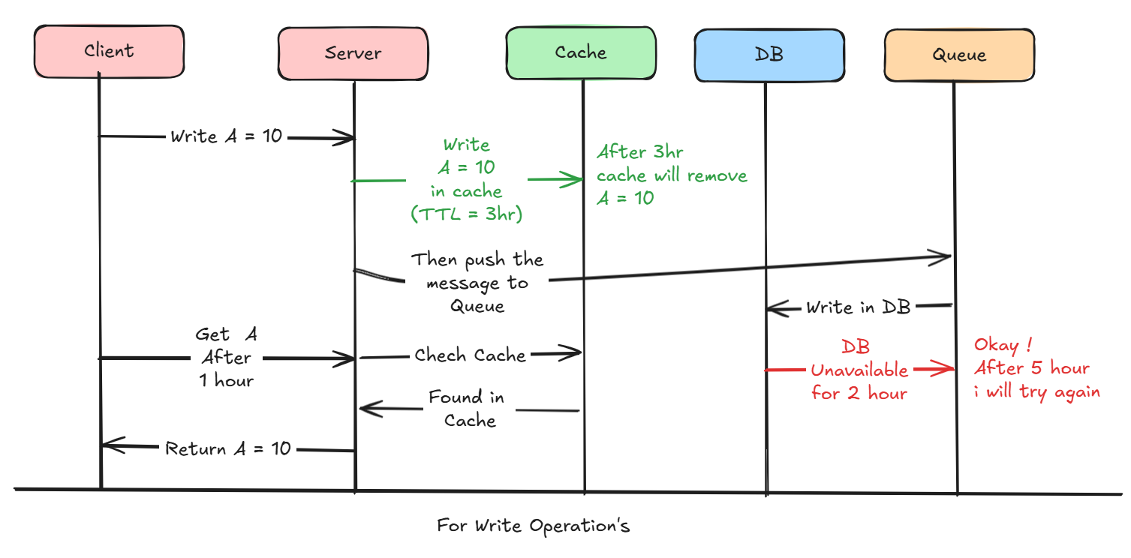

Slide 68
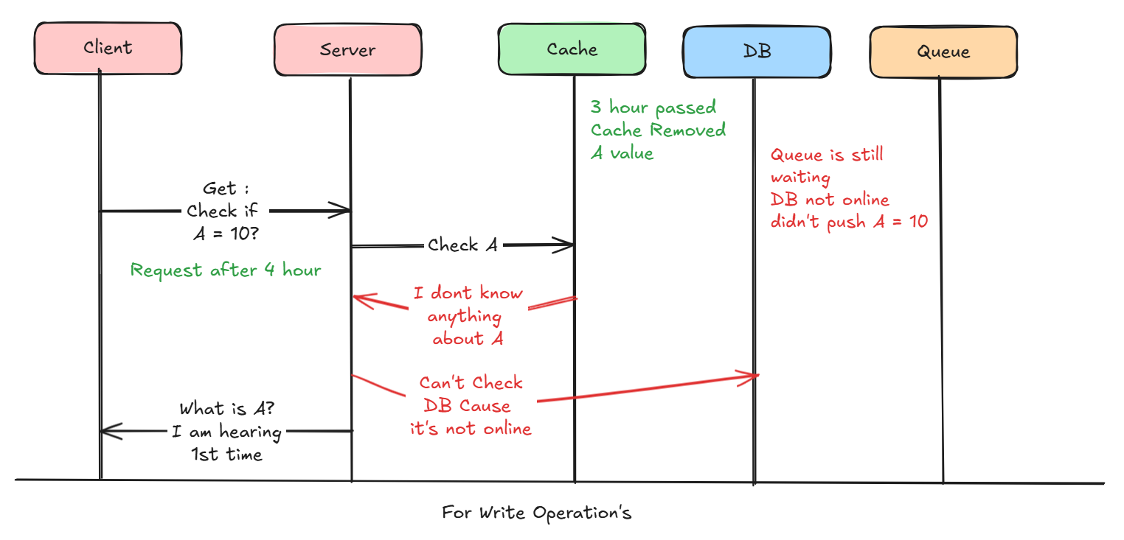

Slide 69


Slide 70
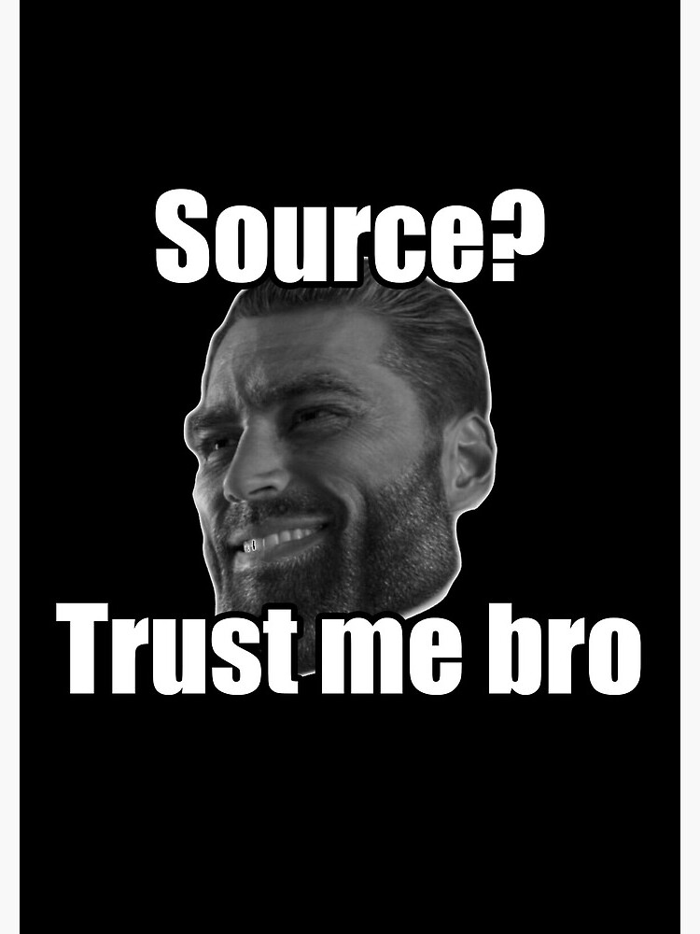

Slide 71
References
https://youtu.be/RtOyBwBICRs?si=IrqpxAe4-qnbXMZB
https://blog.bytebytego.com/p/top-caching-strategies
https://blog.algomaster.io/p/top-5-caching-strategies-explained
https://codeahoy.com/2017/08/11/caching-strategies-and-how-to-choose-the-right-one/
https://youtu.be/2zIFUqTx_TU?si=jeT9xfqCpSKMQ2F4
https://wp-rocket.me/wordpress-cache/different-types-of-caching/

Slide 72


